Slide 1
Securing LAMP
CIS 217

Slide 2
What is LAMP?
LAMP is a nice combination of
Linux
Apache
MySQL
PHP
Each level needs to be secured for the entire installation to be secure

Slide 3
Securing Linux
This can take several classes and years of experience
What you need to know
Make sure the Network / OS admin changes the root password immediately
Never log in as root
Ask the network admin and OS admin what folders have been “locked down”

Slide 4
Linux Groups
Determine what files each group in the company needs
You as a database admin should be in on this discussion
As people are hired, they are added to a group with those permissions

Slide 5
Securing Apache
Harden the Operating system
Uninstall or delete packages not needed
Turn off things that give out too much information

Slide 6
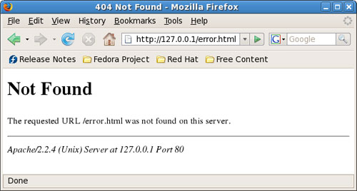
Disable items
ServerSignature in httpd.conf should be set to off
With it on

Slide 7
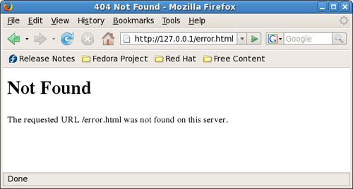
Disable things
With it off

Slide 8
Disable directory browsing
Directory browsing is enabled by default. To disable this feature, edit the httpd.conf file; and, for each "Directory" directive, remove the "Indexes" reference.
For example, on my lab Apache 2.2.4 server, this is the default Directory directive:
<Directory "/usr/local/apache/htdocs"> Options Indexes FollowSymLinks AllowOverrride None Order allow,deny Allow from all </Directory>
Remove the Indexes reference so that this reads: <Directory "/usr/local/apache/htdocs"> Options FollowSymLinks AllowOverrride None Order allow,deny Allow from all </Directory>

Slide 9
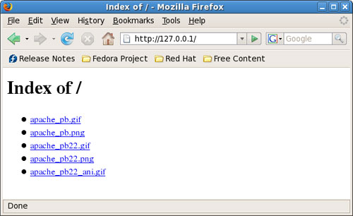
Before change

Slide 10
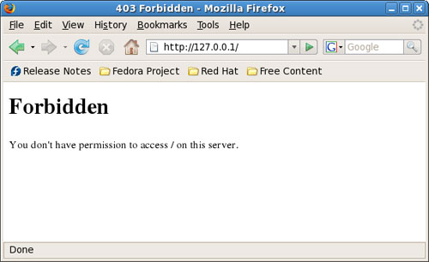
After

Slide 11
Other items
Run mod_security
Module created for Apache
Run as a non-privileged user
Disable symbolic links
Remove default comments

Slide 12
Remove FollowSymLinks
For example, on my lab Apache 2.2.4 server, this is the Directory directive:
<Directory "/usr/local/apache/htdocs"> Options Indexes FollowSymLinks AllowOverrride None Order allow,deny Allow from all </Directory>
Remove the FollowSymLinks reference so that this reads: <Directory "/usr/local/apache/htdocs"> Options Indexes AllowOverrride None Order allow,deny Allow from all </Directory>

Slide 13
Change where it listens
Default is “Listen 80”
Specify the IP address

Slide 14
DoS attacks
Table A
Directive
Apache 2.2/2.3 default
Advice/Description
TimeOut
300 seconds
Should be lowered on sites that are subject to DoS attacks. Setting this to as low as a few seconds may be appropriate, but could pose problems for some CGI scripts.
KeepAliveTimeout
5 seconds
May be also lowered or even disabled (not recommended) on sites that are subject to DoS attacks.
LimitRequestBody
0 bytes (unlimited)
Restricts the total size of the HTTP request body sent from the client. If DoS attacks are occurring as a result of large requests, limit request size.

Slide 15
DoS attacks (cont’d)
LimitRequestFields
100 fields
Limits the number of HTTP request header fields that will be accepted from the client. If DoS attacks are occurring as a result of too many HTTP request headers, lower this number.
LimitRequestFieldSize
8190 bytes
Limits the size of the HTTP request header allowed from the client.
LimitRequestLine
8190 bytes
This directive sets the number of bytes that will be allowed on the HTTP request-line.
MaxClients
256 requests
Sets the limit on the number of simultaneous requests that will be served.

